Slide 1
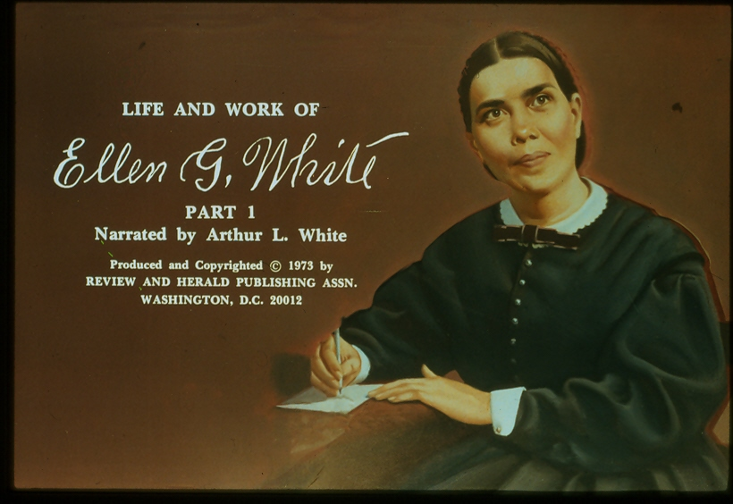

Slide 4
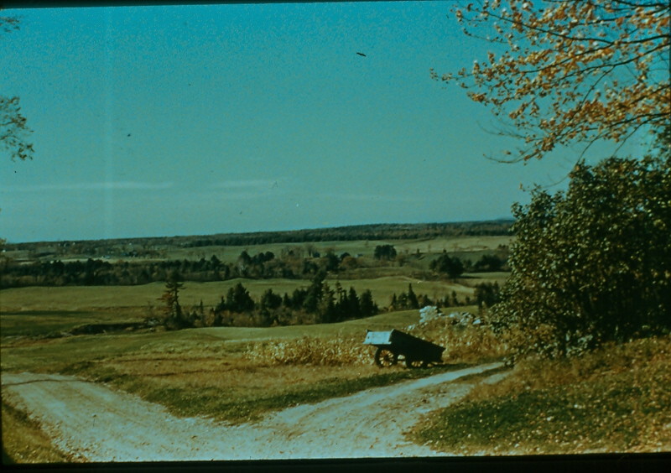

Slide 11
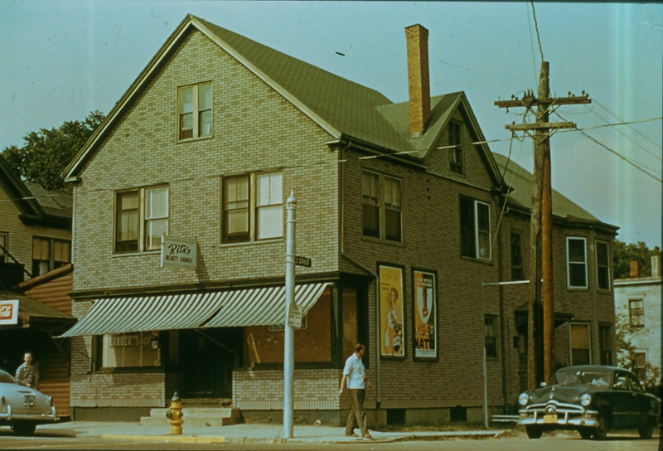

Slide 47
A Soul-Stirring Work
“I write from fifteen to twenty pages a day. It is now eleven o’clock and I have written fourteen pages of manuscript for Volume IV… As I write upon my book I feel intensely moved. I want to get it out as soon as possible, for our people need it so much. I shall complete it next month if the Lord gives me health as He has done.”

Slide 48
“I have been unable to sleep nights, for thinking of the important things to take place. Three hours and sometimes five is the most sleep I get. My mind is stirred so deeply I cannot rest. Write, write, write. I feel that I must and not delay.”

Slide 49
“Great things are before us, and we want to call the people from their indifference to get ready for that day. Things that are eternal crowd upon my vision day and night. The things that are temporal fade from my sight”
~ Ellen G. White in a letter to Elder Uriah Smith
February 19, 1884

Slide 54
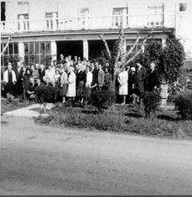

Slide 59
A Great Responsibility
“I walk with trembling before God. I know not how to speak or trace with pen the large subjects of the atoning sacrifice. I know not how to present subjects in the living power in which they stand before me.”

Slide 60
“I tremble for fear lest I shall belittle the great plan of salvation by cheap words. I bow my soul in awe and reverence before God, and say, “Who is sufficient for these things?”
~ Ellen G. White in letter to Elder O.A. Olsen
July 15, 1892

Slide 78
Special Thanks
Pastor Dennis Farley – narrator
Tim Poirer – script editor
Alyssa Benalfew – transcription
Fabio Andrade- transcription

