Slide 1
AFRICAN AMERICAN INVENTORS
Black History Month
By
Laura F. Mayne
Notes:
1. This PowerPoint can be used during Black History Month for an Assembly. Encourage students to do more research on African American Inventors or African American firsts as they learn more about African American History.
2. See lesson plan in January/February Monthlies for lesson plans that could be used with this PowerPoint.

Slide 2
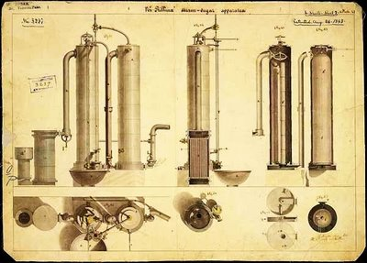
Norbert Rillieux (1806-1894)
An American chemist, the son of an engineer and a freed slave, invented a device to remove the water from the juices of sugarcane and sugar beets to produce dry sugar.
Rillieux's invention enabled a purer sugar product, cost less money, and was far less dangerous to workers than previous methods.

Slide 3
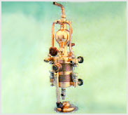
Elijah McCoy (1844-1929)
Elijah McCoy is best known for inventing ingenious devices to lubricate heavy machinery automatically. He is responsible for a remarkable 57 patents.
McCoy's devices were so reliable that people often asked Garrett A. Morgan if machinery contained "the real McCoy," likely giving rise to this enduring expression

Slide 4
Lewis H Latimer (1848 – 1928)
Latimer, draftsman and inventor is best remembered for his key contributions to the incandescent light bulb. He received seven patents for his inventions. In 1881 Latimer patented an electric lamp with an inexpensive carbon filament and a threaded wooden socket. He later joined Thomas Alva Edison's team of inventors and wrote the first known book on electric lighting.

Slide 5
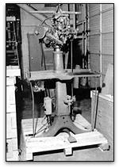
Jan E. Matzeliger (1852-1889)
Matzeliger is most famous for designing and creating a machine that stretched leather shoe uppers around a foot-shaped model. Before he introduced his machine, highly skilled artisans lasted a maximum of 50 pairs of shoes a day. Matzeliger's automatic shoe lasting machine revolutionized the shoemaking industry, producing as many as 700 pairs of shoes in a single day.

Slide 6
George Washington Carver (1864-1943)
Carver developed several hundred industrial uses for peanuts, sweet potatoes, and soybeans, and developed a new type of cotton known as Carver's hybrid. Carver is credited with introducing crop rotation to farmers in the southern United States, thereby revolutionizing the American farming industry.

Slide 7
Sarah Walker 1867 -1919
Sarah Walker created a line of hair-care products especially for black women. Walker, the daughter of Louisiana sharecroppers and nicknamed "Madame C.J.," was the first woman to sell products via mail order and to organize a nationwide membership of door-to-door agents. Madame C.J. is best remembered as one of the first American women of any race to become a millionaire through her own efforts.

Slide 8
Granville T. Woods(1856-1910)
Woods patented a remarkable 35 electrical and mechanical devices during his prolific career. He received his first patent in 1884 for a steam boiler furnace. His many later patents included a system that enabled telegraph lines to carry voice signals; an induction telegraph for sending messages to and from moving trains; and electromechanical and electromagnetic railway brakes.

Slide 9
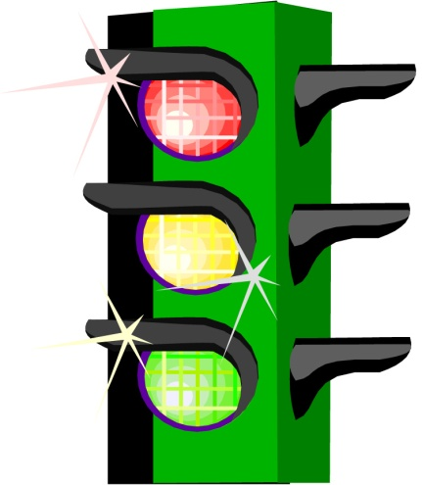
Garrett A. Morgan (1877 – 1963)
Morgan patented the first traffic signal in 1923. Morgan made national news when he used another of his inventions--the gas mask--to rescue several men trapped in a tunnel beneath Lake Erie. Morgan's mask was soon adopted by firemen around the world, and was also refined for use by the United States Army during World War I.

Slide 10
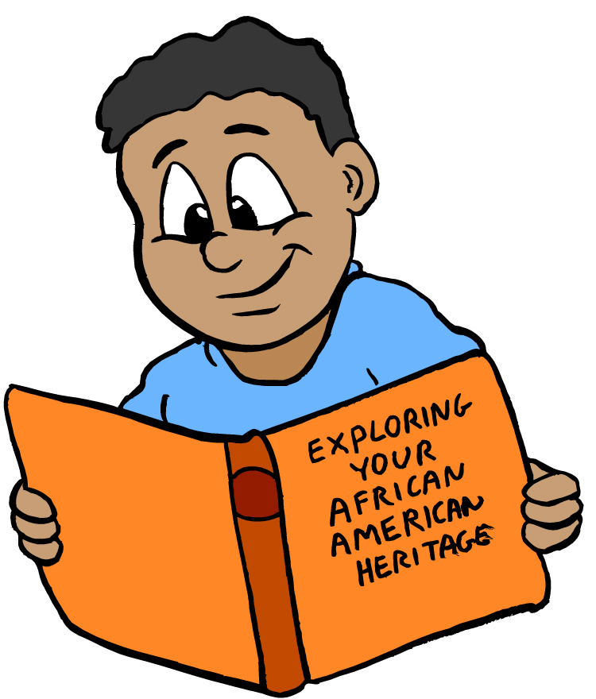
Fredrick McKinley Jones 1893 - 1961
American businessman, inventor, and World War I veteran Frederick McKinley Jones is most remembered for introducing the first practical refrigeration system for trucks and railroad cars, a system that completely changed the food transport industry. Jones was responsible for a phenomenal 60 patents during his lifetime, 40 for refrigeration equipment alone.

Slide 11
Charles Richard Drew 1904 - 1950
American surgeon Charles Richard Drew conducted pioneering work in blood storage and transfusion techniques. Drew showed that blood plasma lasts longer than whole blood, a medical breakthrough that enabled the creation of the modern blood bank. In 1939, Dr. Drew used his new understanding of blood storage and transfusion to help establish the first blood banks to serve the Allied Forces in Europe during World War II. He went on to become the first director of the American Red Cross Blood Bank.

Slide 12
Conclusion
You can't get a blood transfusion, stop at a traffic signal, turn on a lamp, or even put on a pair of shoes without relying on technologies and devices first patented by African Americans. These are just a few of the remarkable African American men and women who changed the way we live our lives.

