Slide 1
POEMS MADE EASY
By
Laura Mayne
Notes:
This PowerPoint lesson can be used when teaching different types of poems. Use it to present formats and examples of poems. It can also be used to review and reinforce concepts types of poems.

Slide 2
ACROSTIC
Example
SNOW
Snow falls on me
Nose is very cold
Outer coat is a must
Wear it with pride
A poem or series of lines in which certain letters, usually the first in each line, form a name, motto, or message when read in sequence.

Slide 3
HAIKU
Haiku is Japanese poetry that reflects on nature and feelings. It consists of three lines. Five syllables in the first line.
Seven syllables in the second line.
Five syllables in the third.
Example
Autumn
As the cool wind blows
Red, yellow, and green leaves fall
Gently to the ground.

Slide 4
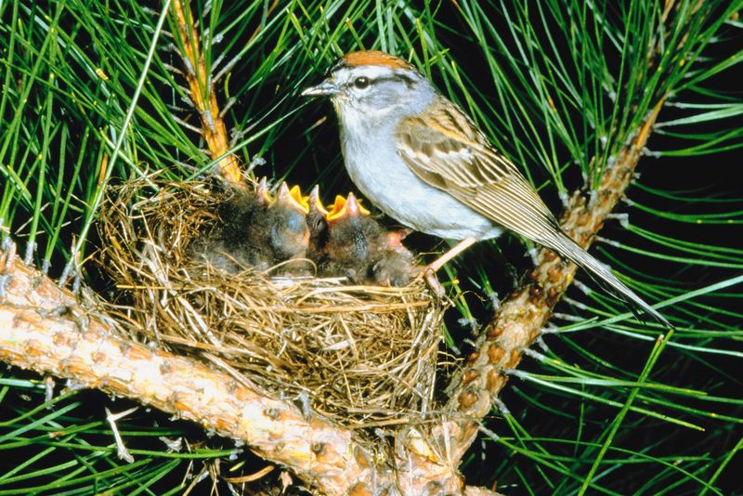
Cinquain
Pattern
Cinquains have five lines
Line 1: Title (noun) 1 word Line 2: (Description ) 2 words Line 3: (Action )3 words Line 4: (Feeling ) phrase 4 words Line 5: (Synonym) for line 1 or a word that sums it up. 1 word
Example
Spring
Fresh, Green
Planting, spouting, Blooming,
The Chirping of Birds
Season

Slide 5
DIAMANTE
Pattern
A seven line poem, shaped like a diamond.
Line 1: Noun or subject - one word
Line 2: Two Adjectives that describe line 1
Line 3: Three 'ing words that describe line 1
Line 4: Four nouns - the first two are connected with line 1; the last two are connected with line 7
Line 5: Three 'ing words that describe line 7
Line 6: Two adjectives that describe line 7
Line 7:one word ( subject/noun that is contrasting to line 1)
Example
Pencil Smooth, skinny Drawing, shading, sketching Wood, lead, ink, plastic Writing, smudging, leaking Strong, secure Pen

Slide 6
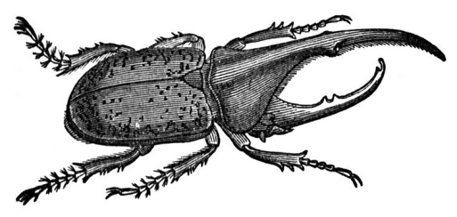
LIMERICK
A light humorous, nonsensical, or bawdy verse consisting of five anapestic lines rhyming aabba. The third and fourth lines having two stresses and the others three.
Example
There was an Old Man of Quebec,
A beetle ran over his neck;
But he cried, 'With a needle,
I'll slay you, O beadle!‘
That angry Old Man of Quebec.
By Edward Lear

Slide 7
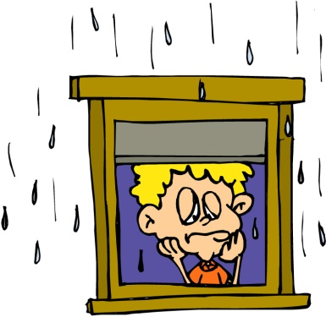
RHYMES
Rhymes are types of poems which have the repetition of the same or similar sounds at the end of two or more words most often at the ends of lines. This technique makes the poem easy to remember and is therefore often used in Nursery Rhymes.
Example
Rain, rain go away
Come again another day
Little Tommy wants to play.

