Slide 1
Poisonous Spiders
By Rebecca K. Fraker
Teacher Bulletin, 2010

Slide 2
Are daddy long legs the deadliest spider?
No, that is a myth!
This myth may have been started because daddy long legs actually prey on one of the more dangerous spiders, the Australian Redback Spider.
http://spiders.ucr.edu/images/holplu1.jpeg

Slide 3
Questions?
Why is it difficult for a doctor to correctly diagnose spider bites?
They oftentimes look like something else such as a rash, bacterial infection, or even diseases like diabetes.
Why do you think it would be unwise to use pesticides for spider control?
You kill not only the bad spiders, but you also take out a natural predator of the bad spider (wolf spiders and giant house spiders do a great job of keeping insect populations and spider populations in check.

Slide 4
How should you protect yourself?
Shake out clothes and shoes before putting them on, especially if they were hung outdoors.
Inspect bedding (sheets/pillow cases) before using.
Bedspreads and bedskirts are potential risks – contact with the floor.
Be careful around woodpiles, rock piles, etc. Wear work gloves when working in these areas.
Pesticides should be a last resort or used only if there is a heavy infestation.

Slide 5
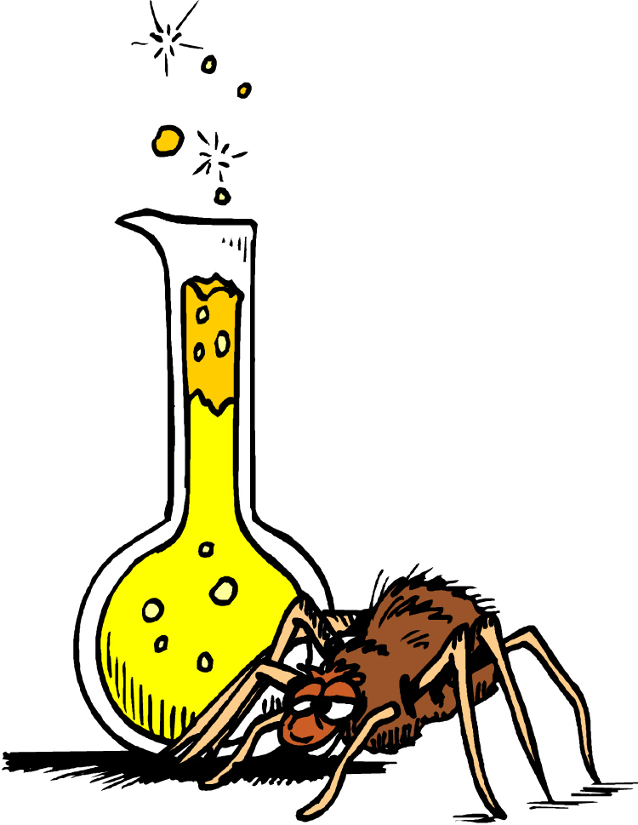
How many spiders are poisonous?
Surprisingly, out of the 90,000+ species of spiders, only a few will cause death in humans.
All spiders have venom, but most do not have enough to kill a person. They use it to paralyze or kill their prey.

Slide 6
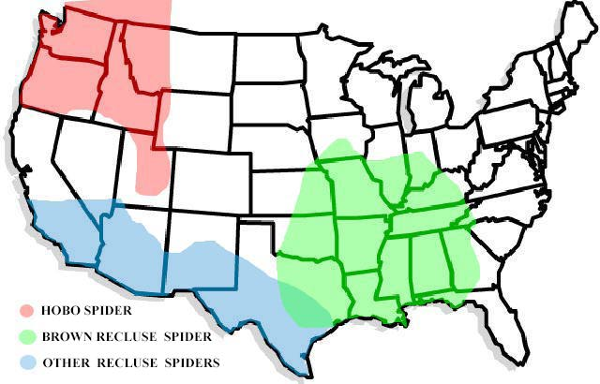
Where in North America are these poisonous spiders?

Slide 7
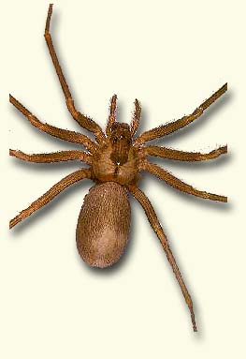
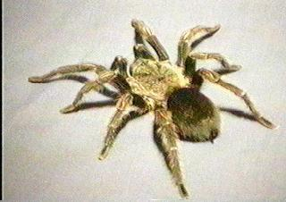
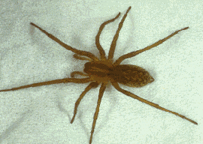
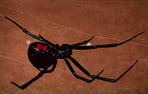
SPIDERS
Fiddle shape
Hourglass shape
Brown Recluse
Tarantula
Hobo
Black Widow

Slide 8
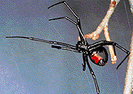
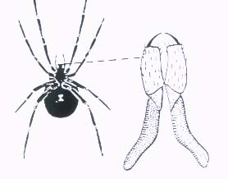
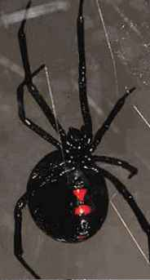
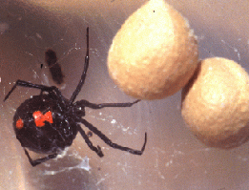
Latrodectus mactans (Black Widow)

Slide 9
The Black Widow Spider
Symptoms of its bite:
Painful bite
Painful rigid abdomen
Severe diffuse muscle pain
Excessive salivation
Sweating
Nausea/vomiting
Difficulty breathing
Headaches
Weakness

Slide 11
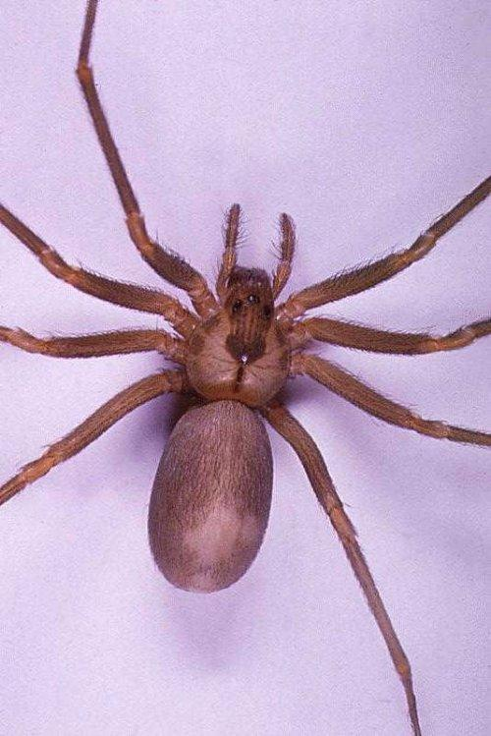
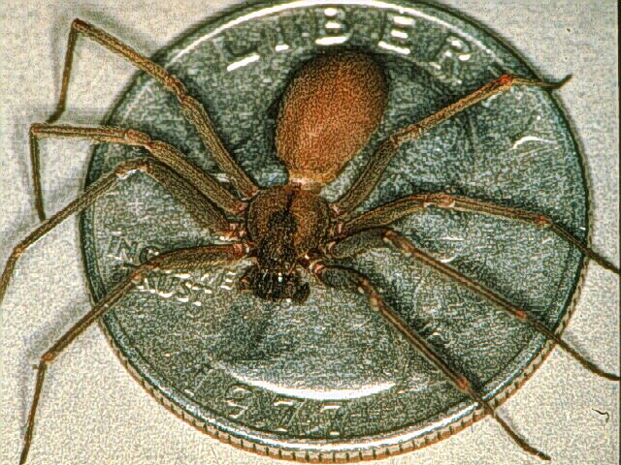
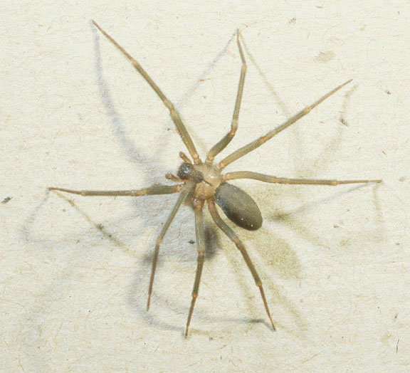
Loxosceles reclusa (Brown Recluse)

Slide 12
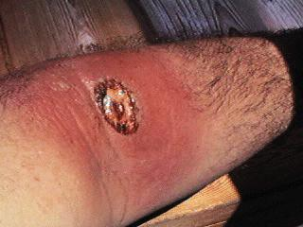
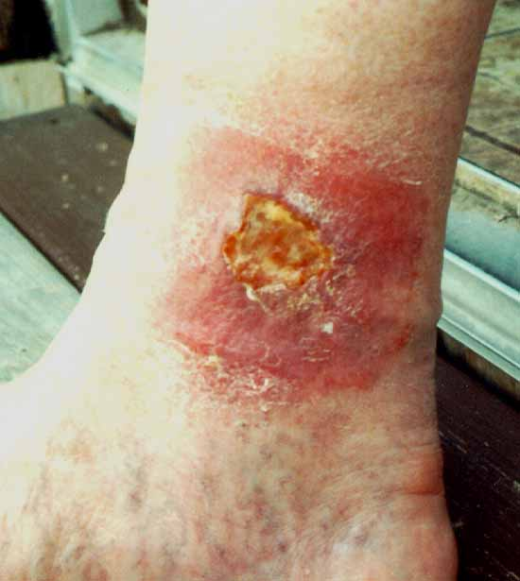
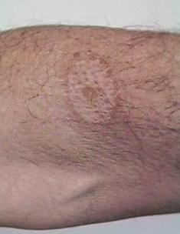
Brown Recluse Bites This is what “necrotic” looks like.

Slide 13
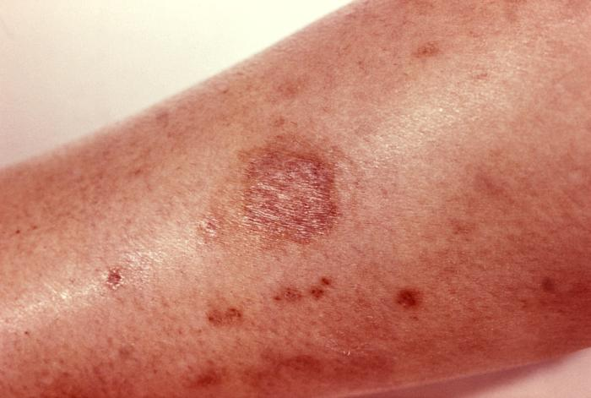
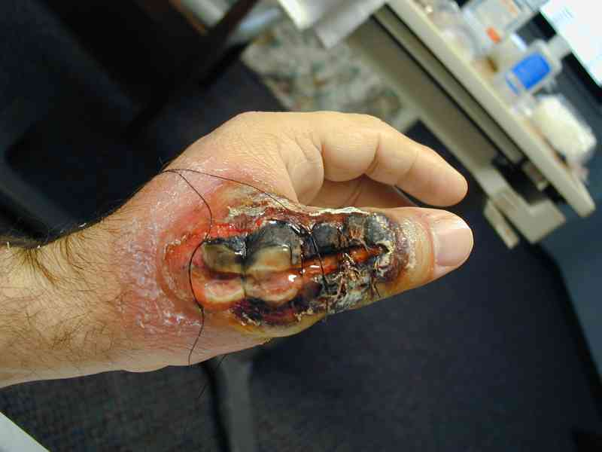
Recluse Spider Bite: A necrotic wound
The stages of a recluse spider bite.
It can often take over a year for it to heal, and it always lets a huge scar.

Slide 14
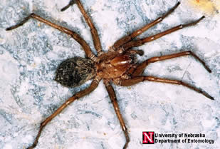
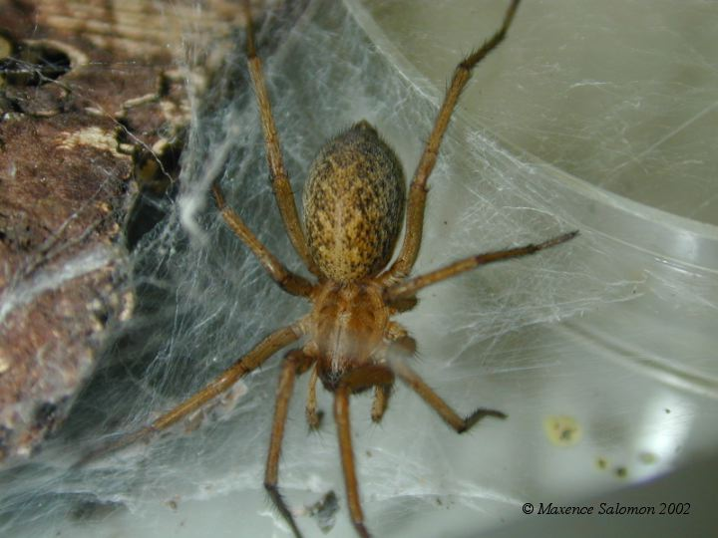
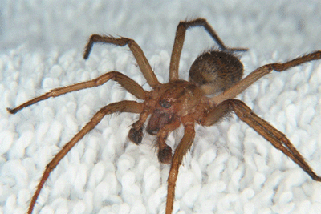
Tegenaria agrestis (Hobo Spider or Aggressive House Spider)

Slide 15
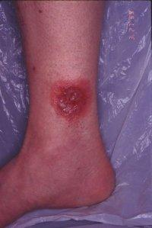
Hobo Spider Bites

Slide 16
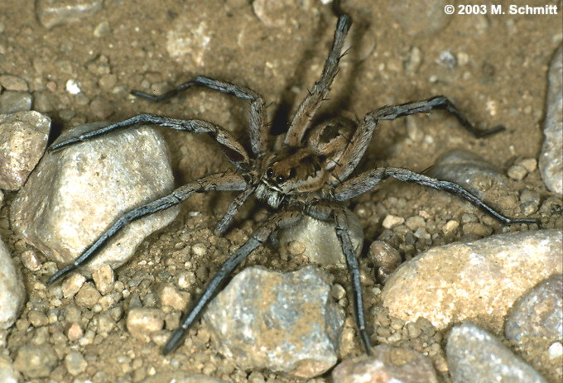
Lycosa tarantula (Wolf Spider)
Occur in Europe and not the U.S.
Not a Tarantula!
1370 recorded biting humans. However, it does not cause
nearly the reactions of the
other poisonous spiders
Tarantism
Named after a dance called the tarantella

Slide 17
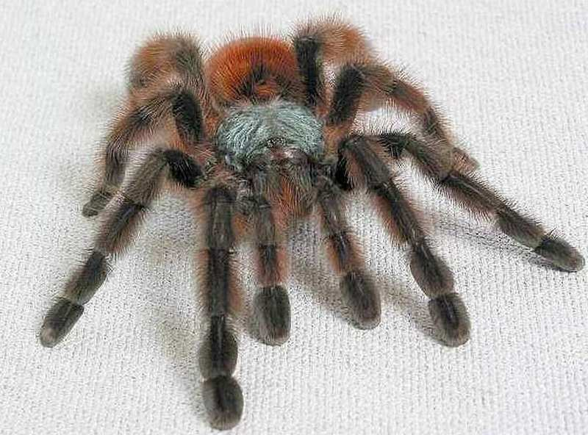
Tarantulas
840 described species
Fangs larger than those of most venomous snakes.
Old world species more venomous than New World species.
Neurotoxic
Most species are harmless!
Symptoms of bites:
Venom is relatively harmless to humans.
The bite is similar to a bee or wasp sting.
If their hairs poke your skin, they can cause a rash, redness and itchiness.
Allergic reactions are unusual.

Slide 18
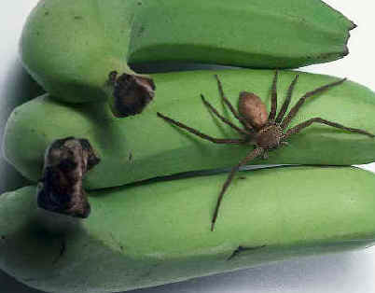
Brazilian Wandering Banana Spider
This spider can be found in South America, Cameroon, Africa, and other countries as well.
It stows away in the center of bunches of bananas and emerges when the bananas are sorted in countries that import bananas.
That means they could show up with your breakfast!
The body of the spider is about 1 inch long and 5 inches in total.

Slide 19
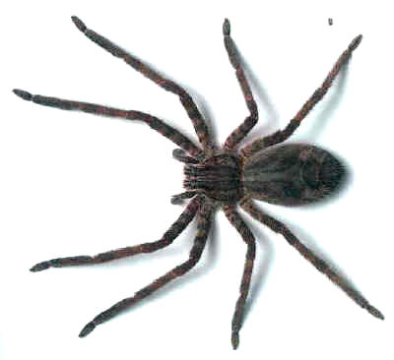
Brazilian Wandering Banana Spider: continued
This spider likes to roam around and hides in any place it finds suitable like cardboard boxes, tree trunks and logs, houses, clothes, shoes, and boots.
It is a very nasty creature and is extremely aggressive. It can run very fast. It is one of the few spiders that will actually attack anything that gets to close to it, including people.

Slide 20
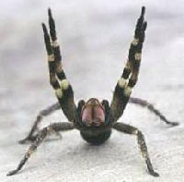
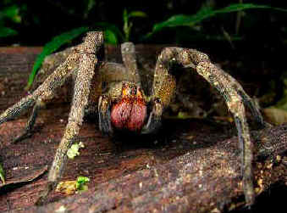
Brazilian Wandering Banana Spider: continued
The neurotoxin from this spider is very potent. Only .006 of a milligram will kill a mouse, and the spider holds enough to kill thousands of mice.
Luckily this spider often gives a “dry bite” without any toxin as a warning shot.

Slide 21
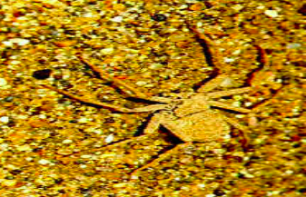
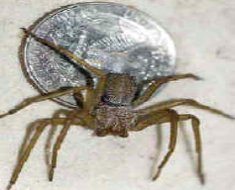
Deadliest Spider in the World: A Recluse named The Six Eyed Sand Spider
Luckily, this is a quiet and shy, fast moving spider.
It is fairly small and lives in the South African desert. It looks like the American Wolf spider.

Slide 22
Don’t be scared!
The vast majority of spiders will not bite, and if they do their venom is so weak you may not even notice!
Staying alert is the best prevention.
If you do get a reaction from a spider encounter, it will probably just be a minor itch or bump.
Anti-venom is available for many bites. Seek medical attention if you think you are seriously bitten.

