Slide 1
WEBS
By Rebecca Kinley Fraker

Slide 2
Sheet Web
Sheet webs do not look planned. Small ones are often called “cobwebs”.
Picture by Rod Crawford

Slide 3
Cobweb
Photo by Jim Stratton

Slide 4
Funnel Web
Almost like a nest, it is deep.
Picture by Rod Crawford

Slide 5
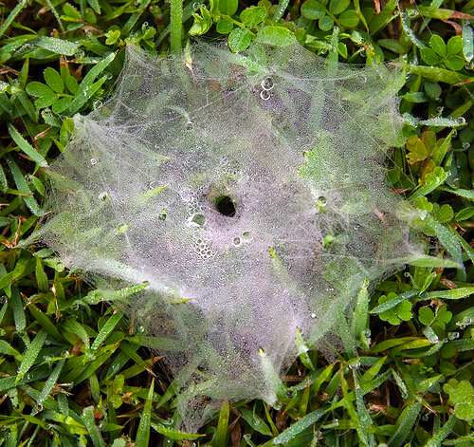
Sheet Web

Slide 6
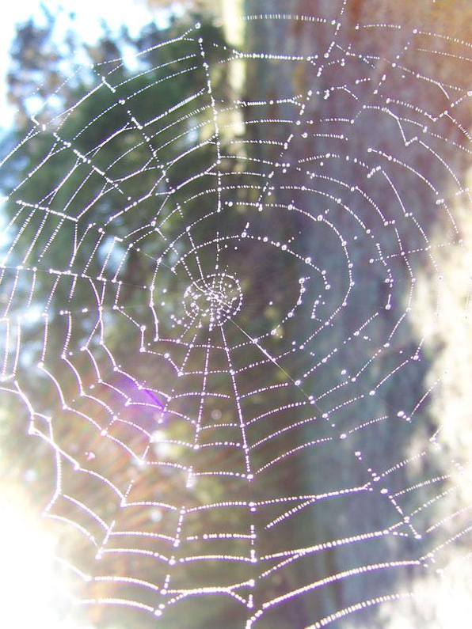
Orb Web
What most people think of as a “spider web”.
Conspicuous because they tend to be large and suspended in midair.
Not the most common type of web.

Slide 7
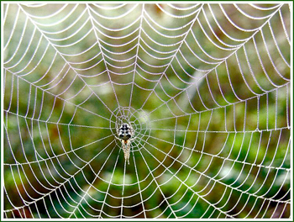
Orb Web
The spider sits in the center and feels vibrations from the prey.

Slide 8
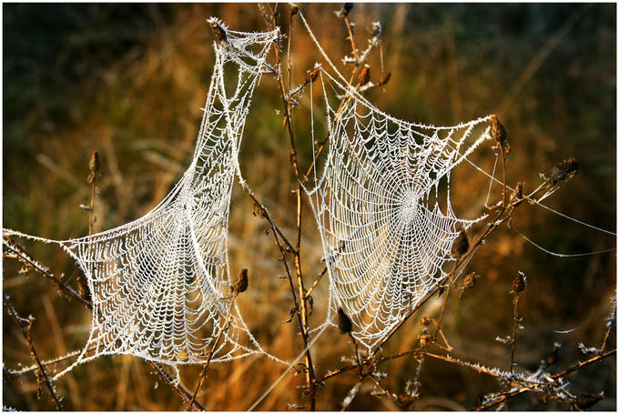
Orb Web

Slide 9
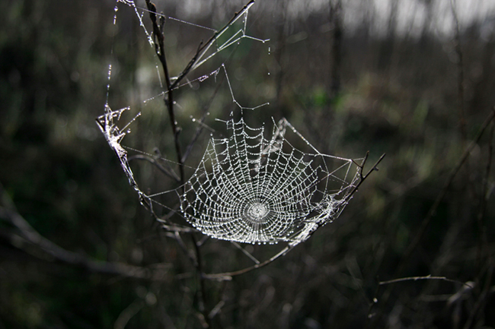
Orb Web

Slide 10
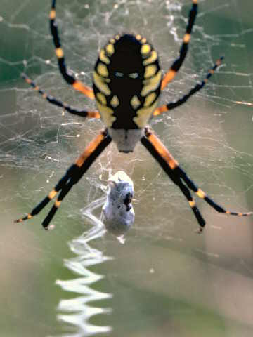

Slide 11
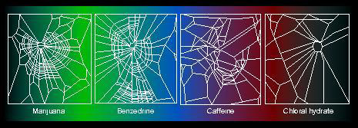
Spiders spin deformed webs when they are exposed to other chemicals such as caffeine or marijuana.

Slide 12
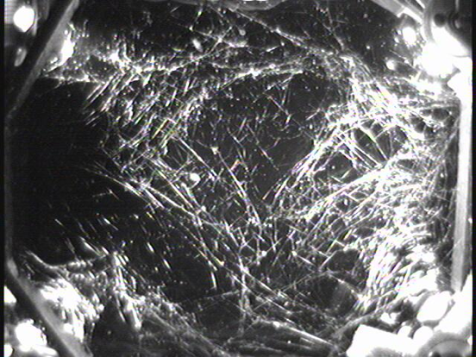
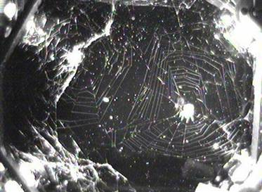
Space Spiders
In 1973, spiders were sent into Space and lived at Skylab. At first their webs were very strange. But after a while, they adjusted and the webs became normal.

Slide 13
Construction of a wheel web
http://www.xs4all.nl/~ednieuw/Spiders/Info/Construction_of_a_web.html
http://www.conservation.unibas.ch/team/zschokke/movie.php?lang=en
http://www.conservation.unibas.ch/team/zschokke/spidergallery.php?lang=en
Animations of spider web building
http://www.arachnology.be/Arachnology.html
Spider thread can stop an airplane.
http://www.xs4all.nl/~ednieuw/Spiders/Info/SilkBoeing.html

