Slide 1
Types of Spiders
By Rebecca K. Fraker, 2010

Slide 2
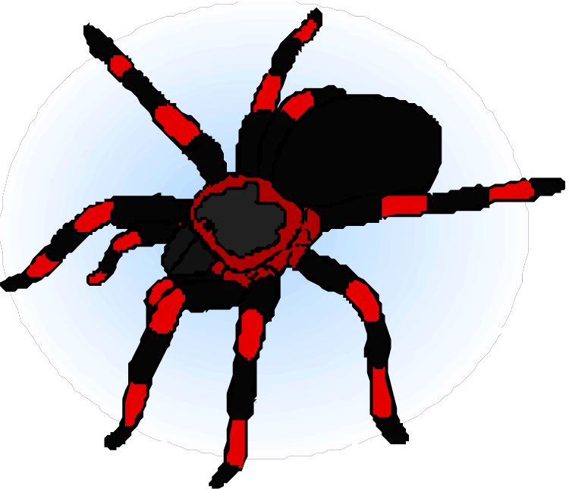
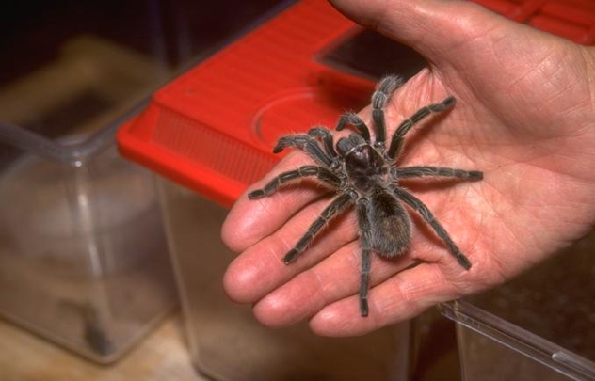
Tarantulas
Very big, hairy spiders
Can be up to 12 inches across
World’s largest spider is the Goliath Bird-Eating Spider, which eats birds, insects, mice, snakes, frogs, and lizards
Found in Central and South America
Mostly nocturnal

Slide 3
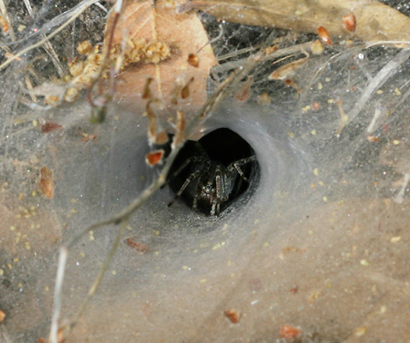
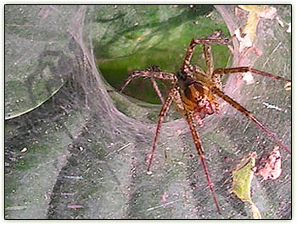
Funnel-web Spiders (Dipluridae)
Make a funnel-shaped web that leads into an underground burrow
Senses vibrations on their webs and rush out to kill its prey
Prey includes insects, frogs, and lizards
Found in a band across the equator in subtropical and tropical regions; up to 5/8 inch
Very poisonous bite

Slide 4
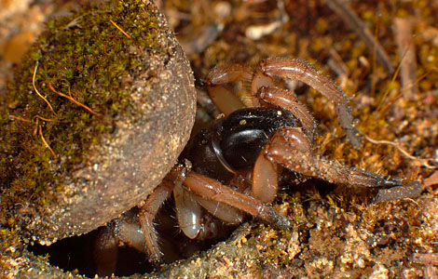
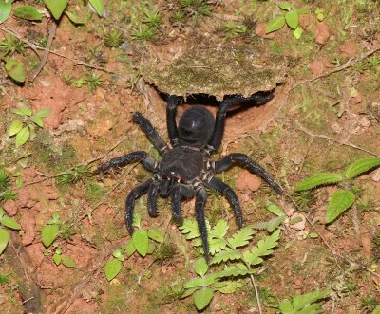
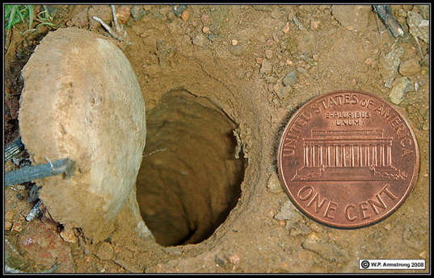
Trapdoor Spiders
Found in Southwest USA, Southern Europe, Africa, Asia, Australia
Dig a burrow with a hinged lid which they line with earth, saliva, and silk
Feel movements through receptors in their legs, and then jump out, grab the prey, and drag it back to the burrow to eat

Slide 5
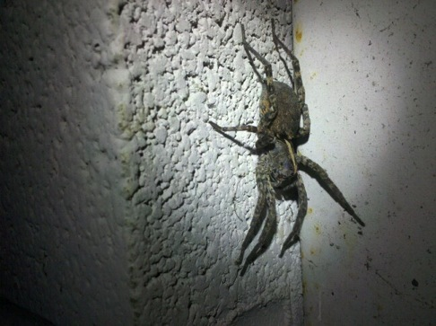
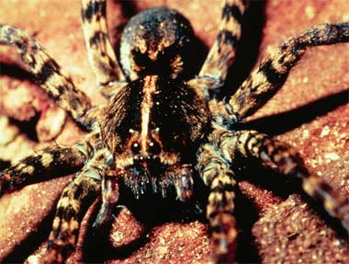
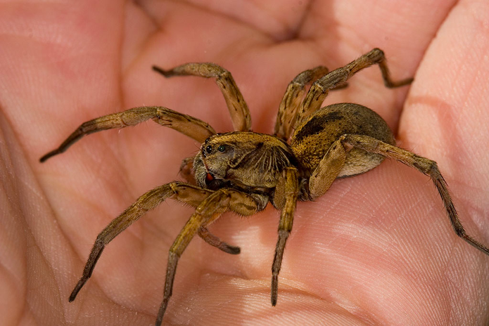
Wolf Spiders
Fast-moving hunters that creep up and then speedily grab the prey
Three rows of eight eyes
Usually hunt at night and rarely make webs
Fairly large, up to 1.5 inches
Found world-wide

Slide 6
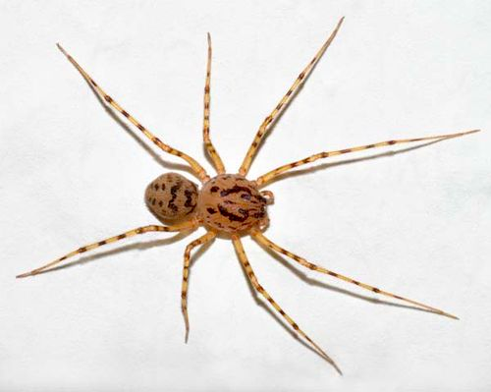
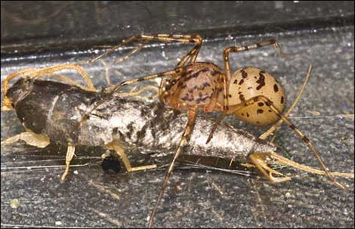
Spitting Spiders
Spit sticky liquid to trap prey
Their bite turns insects into liquid that they suck up
Don’t make webs
Live on the ground and under stones
Carry their eggs until they hatch
Found worldwide
Less that 1/3 inch

Slide 7
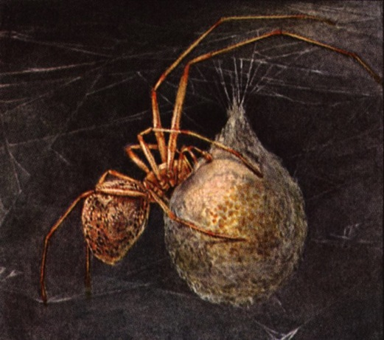
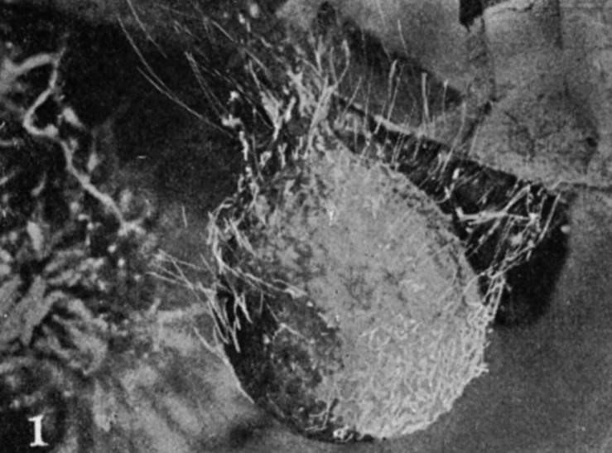
Nursery Web Spiders
Found worldwide except in the Arabian Peninsula
Build webs to protect their young. They carry the eggs until they are ready to hatch. Then they spin a web over the eggs to protect them. As the eggs hatch the mother spiders stand guard.
Live near water

Slide 8
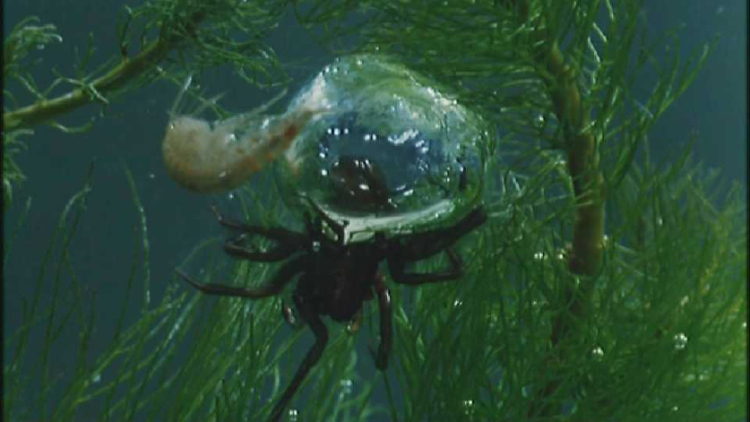
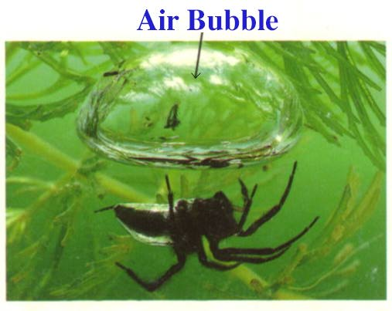
Water Spiders
The only spiders that spend their whole life in water
Make a special underwater shelter in which they can breathe air
They fill the home with bubbles of air they collect at the surface of the water.
They stay in the bell waiting for prey that is then taken inside
Live in Northern Europe

Slide 9
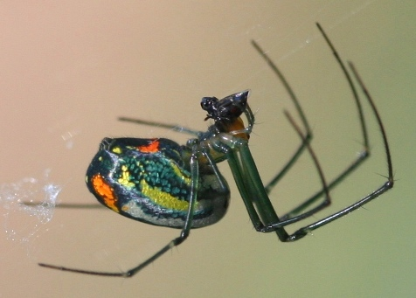
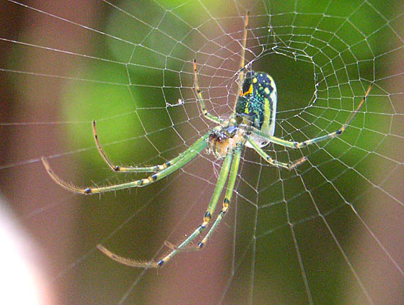
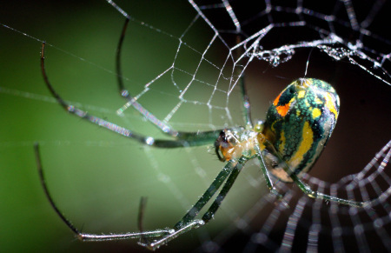
Orchard Spiders
Often very colorful
Found in North and Central America
Make a flattish web to catch their prey

Slide 10
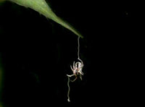
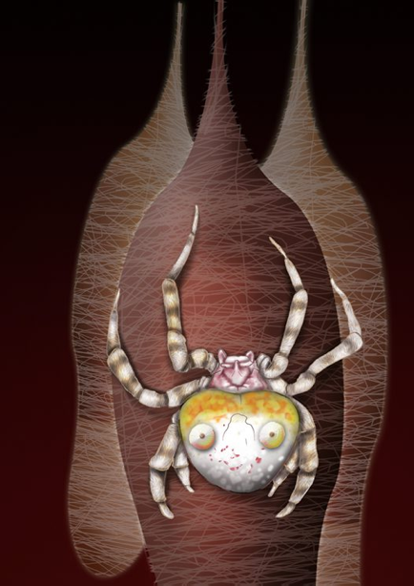
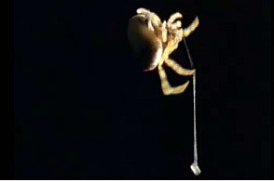
Bolas Spiders
Hunt at night
Use a lure they make of a silken line with a sticky blob of silk at the end that smells like a female moth
When prey investigates it gets stuck and is reeled in
Found in Australia

Slide 11
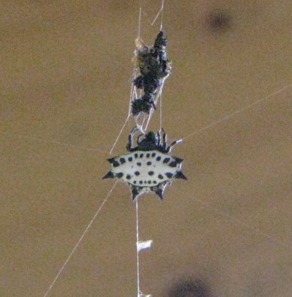
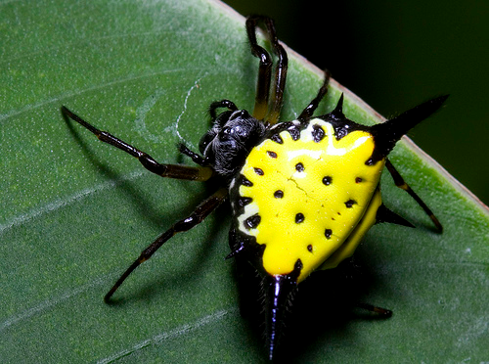
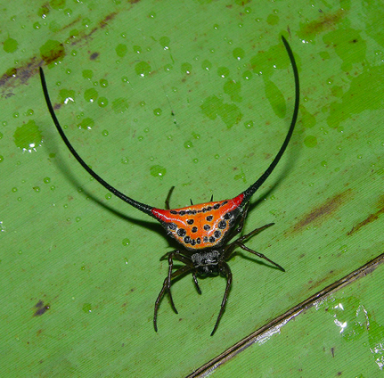
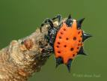
Spiny Orb-Weaver Spiders
Prey is attracted to them by the color
Live across the world in forests
Found in Madagascar, Philippines, Australia, Florida, Thailand, Africa, India, Pakistan and other countries

Slide 12
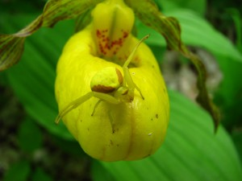
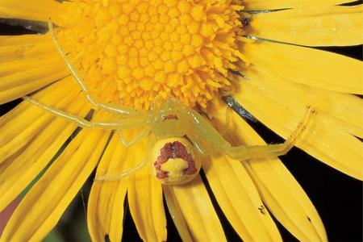
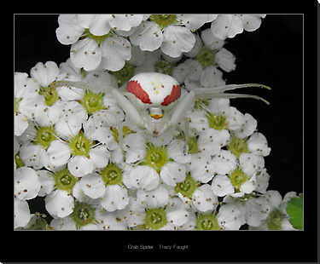
Crab Spiders
Do not make webs
Often colored like the flowers they hide in.
Catch pollinating insects
Rely on camouflage
Scuttle sideways like crabs
Found worldwide; up to 3/8 inches

Slide 13
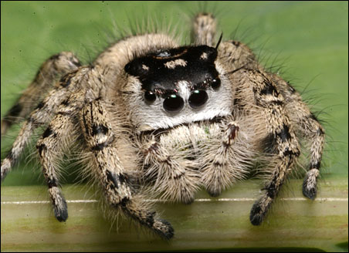
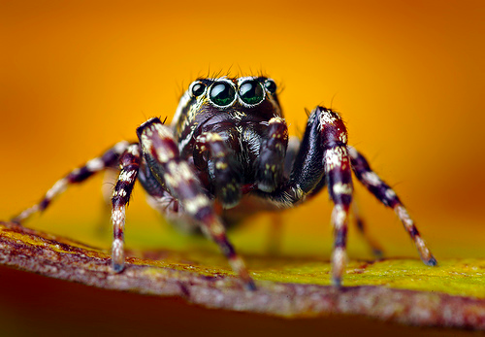
Jumping Spiders
Very good eyesight
Attach a silk thread to the ground as a safety line that they can use to return to their hideout
Do not make webs
Jump up to 50 times their own length to pounce on prey
Found worldwide
About ½ inch

Slide 14
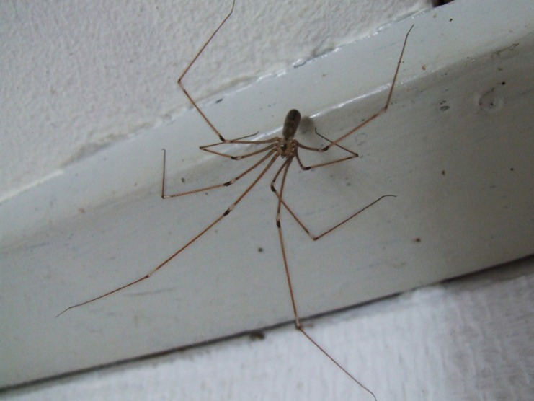
No, this isn’t all of them
There are thousands of spiders around the world. Not all of them have names!
You might find an unnamed one in your own backyard!

