Slide 1
Rational Numbers ~ Comparing Rational Numbers

Slide 2
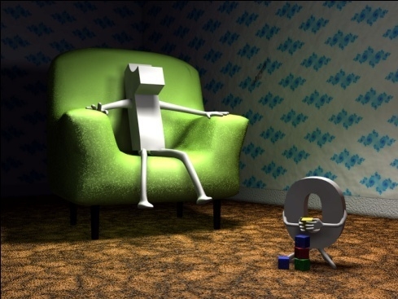
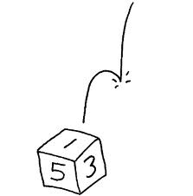
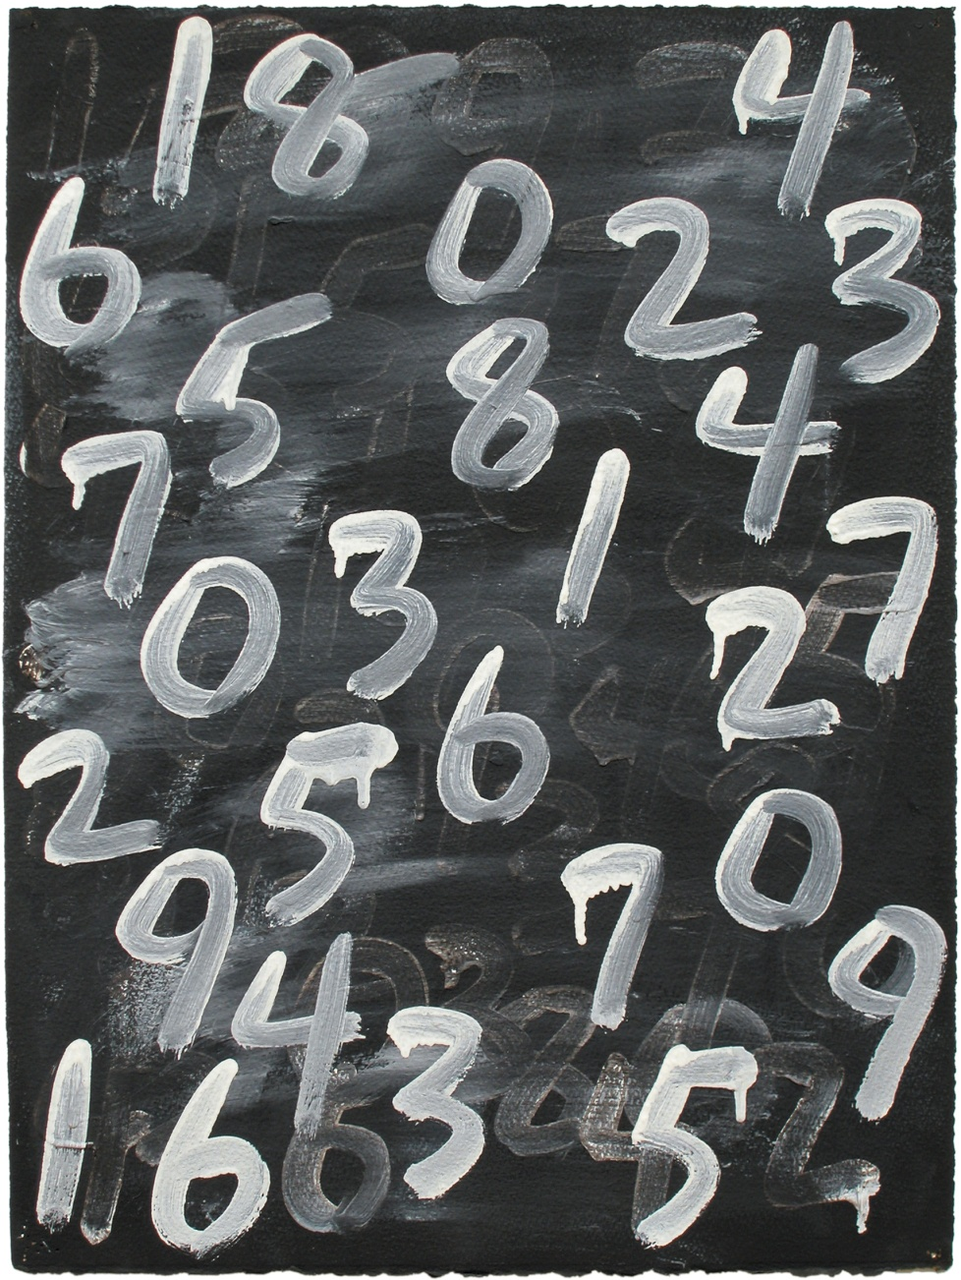
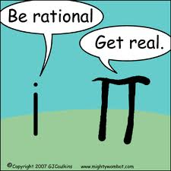
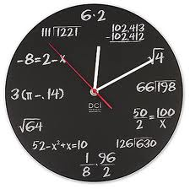
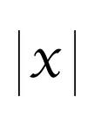
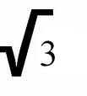
Rational Numbers

Slide 3
RATIONAL NUMBERS? WHAT ARE THEY?

Slide 4
RATIONAL NUMBERS ARE NATURAL NUMBERS
1, 2, 3, 4, 5, . . .
The use of three dots at the end of the list is a common mathematical notation to indicate that the list keeps going forever.

Slide 5
RATIONAL NUMBERS WHOLE NUMBERS
Natural Numbers together with “zero”
0, 1, 2, 3, 4, 5, . . .
At some point, the idea of “zero” came to be considered as a number. If the farmer does not have any sheep, then the number of sheep that the farmer owns is zero. We call the set of natural numbers plus the number zero the whole numbers.

Slide 6
RATIONAL NUMBERS ARE
INTEGERS
Whole numbers plus negatives
. . . –4, –3, –2, –1, 0, 1, 2, 3, 4, . . .

Slide 7
RATIONAL NUMBERS ARE…
All numbers of the form a/b (a divided by b), where a and b are integers (but b is not equal to zero).
Rational numbers include what we usually call fractions.
Notice that the word “rational” contains the word “ratio,” which should remind you of fractions.

Slide 8
THEN THERE ARE THE IRRATIONAL NUMBERS
Irrational numbers cannot be expressed as a ratio of integers.
As decimals, Irrational Numbers never repeat or terminate. (Rational numbers always do one or the other.)

Slide 9
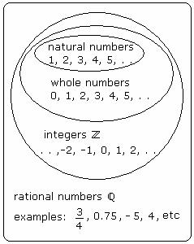
Diagram:
This diagram illustrates the relationships of the sets that make up the real numbers.

Slide 10
Let’s be even more specific….

Slide 11
Rational Numbers are….
Positive numbers – numbers greater than zero.
0
1
2
3
4
5
6

Slide 12
Rational Numbers are….
Negative numbers – numbers less than zero.
-6
-5
-4
-3
-2
-1
0
1
2
3
4
5
6

Slide 13
Rational Numbers are….
Opposite Numbers – numbers that are the same distance from zero in the opposite direction
-6
-5
-4
-3
-2
-1
0
1
2
3
4
5
6

Slide 14
Rational Numbers are….
Integers – Integers are all the whole numbers and all of their opposites on the negative number line including zero.
7
-7
opposite

Slide 15
Use a number line
To compare integers, plot the points on the number line. The number farther to the right is the larger number
Compare 1 and -3
___________ *_______*_______________
-8 -7 -6 -5 -4 -3 -2 -1 0 1 2 3 4 5 6 7 8
Since 1 is to the right of -3, 1 > -3 or
Since -3 is to the left of 1, -3 < 1

Slide 16
Use a number line
To order integers from least to greatest, draw a number line and plot the points.
Order the integers -4, 7, 3, -2, and 1 from least to greatest.
_________*____*_____*___*_________*_
-8 -7 -6 -5 -4 -3 -2 -1 0 1 2 3 4 5 6 7 8
Order the integers by reading from left to right.
-4, -2, 1, 3, 7

Slide 17
Identifying Positive and Negative Integers on a Number Line
Numbers to the right are greater than zero.
Numbers less than zero are to the left of zero.
-5 is five points to the left of zero.
+9 is nine points to the right of zero.

Slide 18
Comparing and Ordering Integers
Order from least to greatest: 4, -6, 2, 9
-6, 2, 4, 9
Order from greatest to least: 5, -9, 9, -5
9, 5, -5, -9

Slide 19
Comparing Integers
< is less than
> is greater than
= has same value
6 8
- 4 7 10
5 -3
4 6 12
2 2 9
<
<
<
>
<
<
=
<

Slide 20
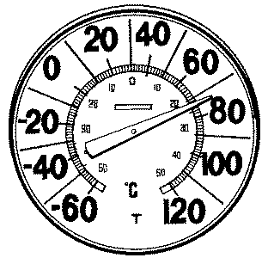
Negative Numbers Are Used to Measure Temperature
WHERE ARE THE NEGATIVE NUMBERS FOUND?

Slide 21
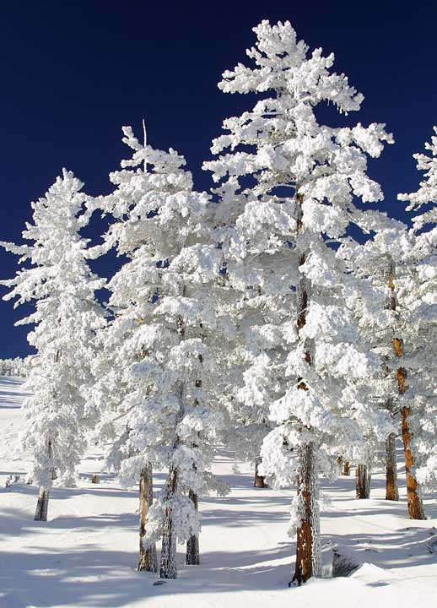
During one week last year the coldest temperatures each day were: -6º, +7º, +8º, -2º, and -1º.
Order the temperatures from coldest to warmest or least to greatest.
-6º, -2º, -1º, +7º, +8º

Slide 22
Order from greatest to least:
5, -10, 6, -4, 2
6, 5, 2, -4, -10

Slide 23
Order from least to greatest:
-100, 4, -55, 15, 0
-100, -55, 0, 4, 15

Slide 24
Student Activity
You will now receive a worksheet.
Turn the worksheet in when completed.

Slide 25
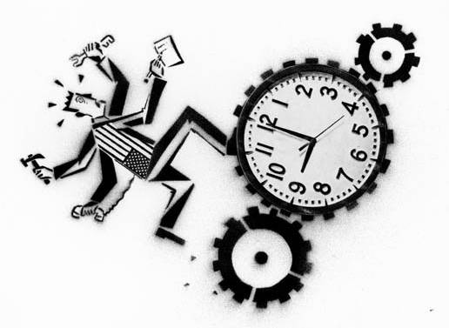
Do Not Disturb Work In Progress

