Slide 1
M. C. Escher’s TESSELLATIONS
By Rebecca K. Fraker
Atlantic Union Conference
Teacher Bulletin 2013

Slide 2
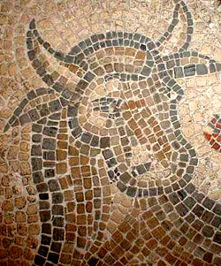
What are Tessellations?
The word 'tessera' in Latin means a small stone cube.
They were used to make up the mosaic pictures forming floors and tilings in Roman buildings
Tessellation refers a repetition of a shape or shapes that cover the surface of a plane without overlapping or leaving gaps.
A Roman floor mosaic

Slide 3
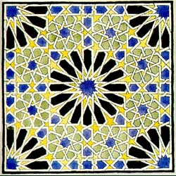
The Beginnings
The tilings in the Alhambra in Spain were laid out by the Moors in the 14th century.
They are not always pure tessellations
Colored tiles formed patterns
Many are truly symmetrical.
They inspired young M.C Escher, who copied them into his notebooks and later converted some into true tessellations.
Escher's drawing of Alhambra tiling.

Slide 4
The Alhambra Palace, Granada, Spain, 12th-13th Century
Reflective Symmetry noted in the lower tile patterns

Slide 5
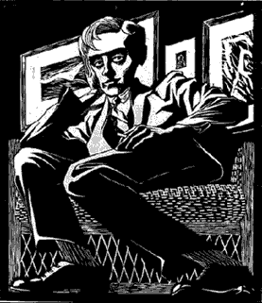
M. C. Escher
Escher was born in Leeuwarden, Holland on June 17th, 1898.
He was not a good student of math, yet he began to use mathematical patterns and relationships in his art after visiting the Alhambra Palace.
'Self Portrait in Chair' - 1920

Slide 6
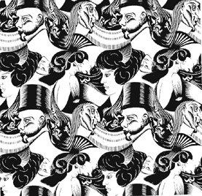
M. C. Escher
Escher produced '8 Heads' in 1922 - a hint of things to come.
Look at the pictures from all angles if you can’t see all of them.
'8 Heads' - 1922

Slide 7
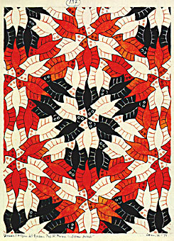
Escher’s Last Tessellation
His last tessellation was a solution to a puzzle sent to him by Roger Penrose, the mathematician.
Escher solved it and changed the angular wood blocks into rounded 'ghosts'.
Penrose 'Ghosts' - 1971

Slide 8
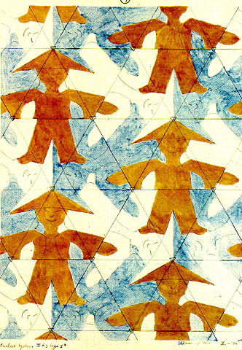
China Boy, 1936
Tessellation by M. C. Escher

Slide 9
Squirrels, 1936
Tessellation by M. C. Escher

Slide 10
Fish, 1938
Tessellation by M. C. Escher

Slide 11
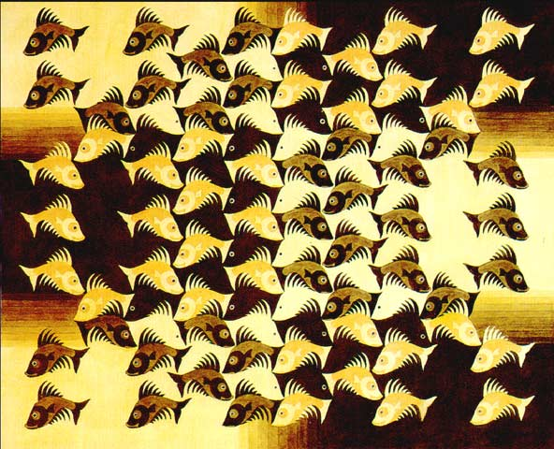
Design for Wood Intarsia Panel for Leiden Town Hall, 1940
Tessellation
transitions
by M. C.
Escher

Slide 12
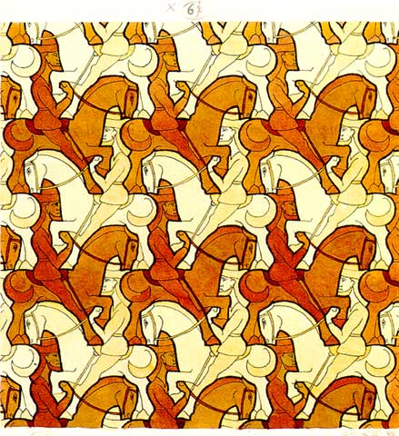
Horsemen, 1946
Tessellation by M. C. Escher

Slide 13
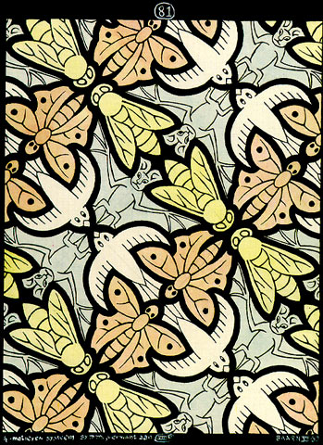
4 Motifs, 1950
Tessellation by M. C. Escher

Slide 14
Scarabs, 1953
Tessellation by M. C. Escher

Slide 15
Fishes, 1958 Mural
Tessellation mural by M. C. Escher

Slide 16
Pegasus, 1959
Tessellation by M. C. Escher

Slide 17
Birds, 1967
Tessellation by M. C. Escher

Slide 18
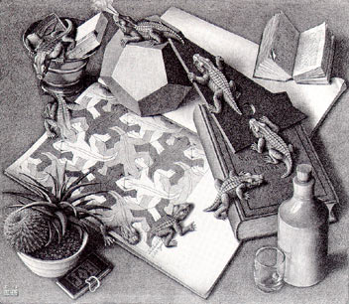
Realism & Tessellations Combined
Sometimes, M. C. Escher would combine realism and tessellations.
Reptiles is an example of this combination.
'Reptiles' - 1943

Slide 19
Metamorphosis I, 1937
by M. C. Escher
Realism & Tessellation Combined

Slide 20
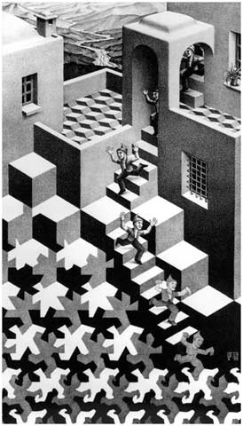
Cycle, 1938
by M. C. Escher
Realism & Tessellation Combined

Slide 21
Day and Night, 1938
by M. C. Escher
Realism & Tessellation Combined

Slide 22
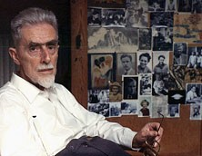
Showing Mathematics in Art
Escher died on March 27, 1972.
He had produced
448 woodcuts, linocuts and lithos and
over 2,000 drawings.
M. C. Escher
Rhomboid possibilities - 1937 notebook

Slide 23
Copyright Laws Disclaimer
Certain materials are included under the Fair Use Exemption of the U. S. Copyright Law and are restricted from further use.
This presentation with images and web links is for educational use only. Escher’s art can be purchased many places.
The information contained in this presentation is accurate to the best of my knowledge.
As a resource, these websites were used:
http://www.mcescher.com/
http://www.tessellations.org/ http://library.thinkquest.org/16661/escher.html http://www.herakleidon-art.gr/

