Slide 1
SYMMETRY: Math and Art
By Rebecca K. Fraker
Atlantic Union Teacher Bulletin
June 2012

Slide 2
Types of Symmetry
Reflection/flips
Translation/slides
Rotation
Notes:
These will be explained on the next few slides.

Slide 3
Materials needed for lessons:
Scissors & a small mirror & a ruler (can be shared)
Piece of paper about the size of an index card
Several sheets of copier paper
Pencil & pushpins
Compass & protractor (can be shared)
Instructions:
Cut a shape out of the paper. It can be a thick letter, a random shape, or a scalene triangle.
Notes:
Instruct students to not use a square, rectangle, triangle, or other regular polygon for this activity. While they will translate, rotate, and reflect, it is not always easy to tell the difference.

Slide 4
Reflective Symmetry
Every reflection (a mirror reflection) has a line of symmetry. Some have more than one. A “mirror image” can also be called a “flip.”
Illustration: http://mathforum.org/sum95/suzanne/symsusan.html
Notes:
There is a worksheet in the lessons that works with the symmetries in the letters of the alphabet.

Slide 5
Examples of Reflective Symmetry
Can you find the line of reflection in each object? (click to see)
Notes:
Click to see the line of reflection in each object

Slide 6
Instructions:
Place your object on a flat surface.
Put a mirror at a 90 degree angle to your object. Notice how it reflects. Move the mirror farther away and watch what happens.
Now draw a straight line on your paper. This will be your line of reflection.
Make your object reflect across the line.
Notes:
Students should notice that the farther an object is from the mirror, the farther its reflection is in the mirror.

Slide 7
Translational Symmetry
Every translation has a distance and a direction.
Translations are not rotated or reflected…the shape remains the same size. A translated object can go up, down, sideways, or diagonally.
Illustration: http://mathforum.org/sum95/suzanne/symsusan.html

Slide 8
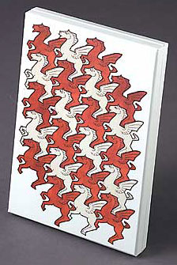
Examples of Translational Symmetry
Quilt
Quilt
Quilt
The objects simply move from one position to another retaining size and shape.
Notes:
Click for samples of where the object might have translation. The Escher art has multiple translations.

Slide 9
Materials needed:
Object from previous lesson.
Blank paper
Pencil
Instructions:
Trace the object on the paper. Now move it in any direction, and trace it again.
Describe what you did using compass directions and distance in centimeters.
This is translational symmetry or a slide.
Notes:
You may want to have students put a simple compass rose on their paper to make the directions easier to determine. Remember, the object should NOT be rotated or change its size.

Slide 10
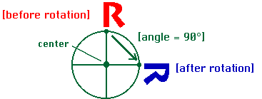
Rotational Symmetry
Take an object and rotate it by some degree (90, 45, 180) and you have an example of rotational symmetry.
Every rotation has a center and an angle!
Illustration: http://mathforum.org/sum95/suzanne/symsusan.html
Notes:
Please note that all the symmetries can overlap. This can make it difficult to identify which ones they are. Many art designs are combinations of of several symmetries.

Slide 11
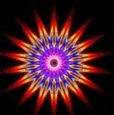
Examples of Rotational Symmetry
Find the centers of all three objects. Now choose a section that appears to be repeated. How many degrees has it been rotated?
Notes:
In the spirograph picture, there are rotations of MANY degrees. If the students say one point is the object, then it was rotated about 20 degree’s each time. If they say ½ the picture was rotated 180 degree’s that is also correct!
For the flower, if one petal is the object of rotation, then it rotates about 72 degrees each time (360/5). This object also has line symmetry…but not everywhere.
For the word ‘rotational’, the object has rotational symmetry of 180 degrees.
You can find rotational symmetry in nature, architecture and even dishes…what else?

Slide 12
Materials needed:
Your object from the previous lesson, a pencil, blank paper a compass and a protractor, and a tack.
Instructions: Read instructions, then look at the illustrations on next slide.
Put a dot in the center of your paper.
Draw a large circle around the center.
Tack a vertex (corner) of your object to the
dot. This will work easier if you have a notebook under the paper.
Trace the object. Now move it around the tack. This is rotating it. Measure how far you rotated it in degrees. Record that number on your paper as well as the direction that you moved it (clockwise or
counterclockwise.)
Notes:
The circle is merely there as a guide to make it easier to measure the angle.

Slide 14
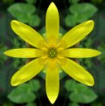
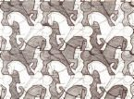
Multiple forms of symmetry can be found in one object…can you name the ones found here?
The flower has rotational and/or reflective symmetry.
The horses and riders were reflected and then translated.
Notes:
The flower has rotational and/or reflective symmetry.
The Escher Art has reflective…then it is translated (that makes it a tesselation)

Slide 15
Final Project
Using one or two of the symmetries shown, construct a piece of art. This piece of art may use a repeated indeterminate object or a more realistic object. Please add color.
The final piece will:
…be 8 x 10 or larger
…use at least 2 colors
…have an example of at least two of the symmetries
…include a note pointing out which symmetries are present
Notes:
These can be very simple. As we move on to Tessellations, the art will become more complex. Here the objects can overlap.
http://www.shodor.org/interactivate/activities/tessellate/

