Slide 1
What Are Human Rights?
Do YOU have them?
Does your NEIGHBOR?
Rebecca K. Fraker, July 2013, ppt #1
Atlantic Union Teacher Bulletin

Slide 2
What do human beings need to live?
What basic things do human beings need to survive?
What is the difference between wants and needs?
Notes:
As a group, list the things that human beings need to survive. These should include: food, water, shelter, clothing. Guide the group to consider companionship, love, protection, and a belief system as well.
Discuss the difference between needs (what you must have to survive) and wants (the frills). Have students list some of the wants they have and some of the “wants” they already own. Lower and middle grades could draw these or cut out pictures.

Slide 3
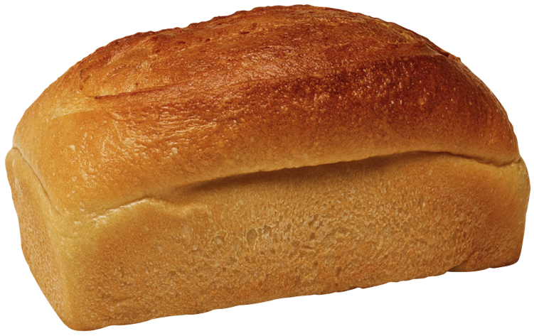
Basic Needs
All human beings have similar basic needs:
Nutritious food
Clean pure water
Shelter
Adequate clothing
Protection from harm
Love and nurturing

Slide 4
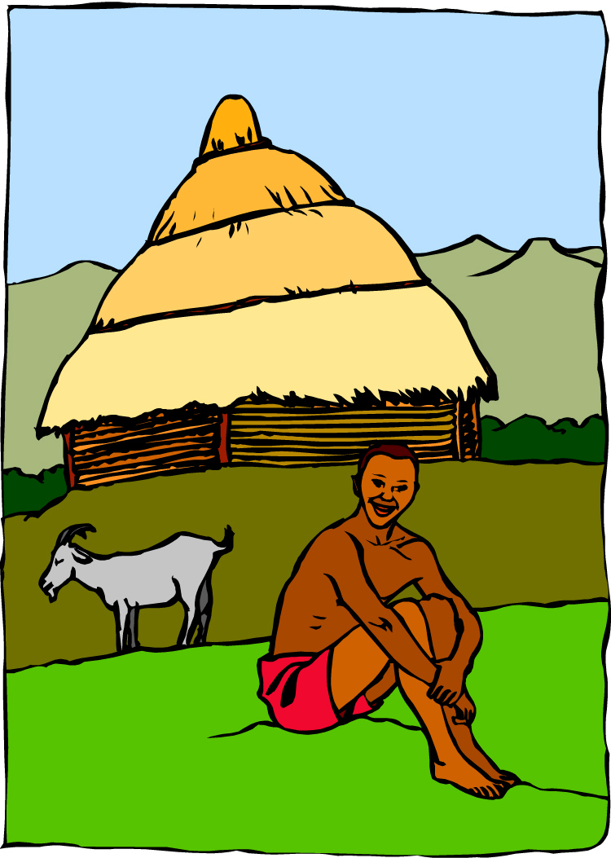
Basic Needs
Discuss each of these and decide if you consider them needs:
Health care
A belief system or religion
An iPod, iPad, laptop, iPhone, or up to date technology
Education past the 8th grade
Notes:
Discuss each of the topics and decide whether you think they are needs or not.

Slide 5
Human Rights
Human beings need these things to live and grow and develop.
Needs are different from wants. Although wants make our lives nicer, they are not necessary for us to survive.
Everyone has the right to have these needs met.
These rights are called human rights.

Slide 6
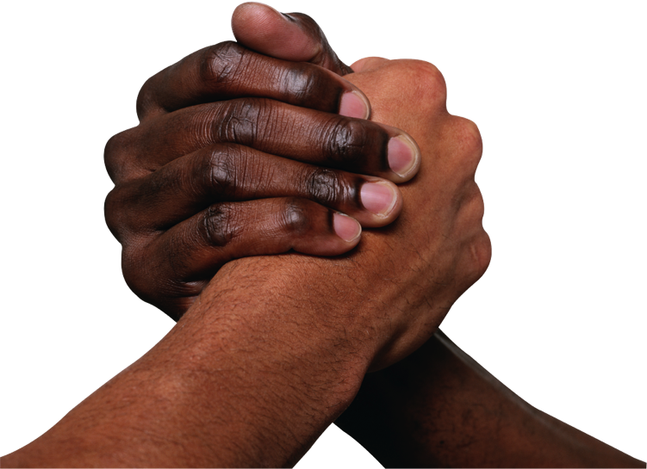
Your Rights, My Rights
Human Rights support all areas of our lives, such as:
the right to have your own thoughts, beliefs, and religion
the right to have an education
the right to not be treated as a slave
the right to live in safety

Slide 7
You can think of Human Rights as a set of rules that state what we all need to live and grow, and how we should treat each other.

Slide 8
Religions
In the Christian Bible we can find “The Golden Rule”.
“Therefore, whatever you want men to do to you, do also to them, for this is the Law and the Prophets.”
Matthew 7:12
Religions give rules for how to treat other people.
There are many good rules in religions; however not all religions grant people all their basic rights.

Slide 9
The Ten Commandments
Exodus 20
You shall have no other Gods before Me.
You shall not make for yourself any carved image of anything to worship.
You shall not take the name of the Lord your God in vain.
Remember the Sabbath Day to keep it holy. Six days you shall labor and do all your work, but the seventh day is the Sabbath of the Lord your God.
…..continued
The Ten Commandments are the basis for laws and moral codes all over the world.
They are found in the book of Exodus in Jewish and Christian Bibles.
The Bible says that they were written in stone by the finger of God, and given to Moses on Mt. Sinai.
Notes:
Here are the the Bible commandments that deal with the relationship between God and man

Slide 10
The Ten Commandments
Exodus 20
Honor your father and mother.
You shall not murder.
You shall not commit adultery.
You shall not steal.
You shall not bear false witness against your neighbor. (Do not lie.)
Do not covet what is owned by your neighbor.
The second part of the Ten Commandments deal with the relationships between human beings.
Notes:
Notice that if these rules were kept, it would eliminate most of the problems we cause ourselves and leave us free to solve the problems such as hunger and clean water.

Slide 11
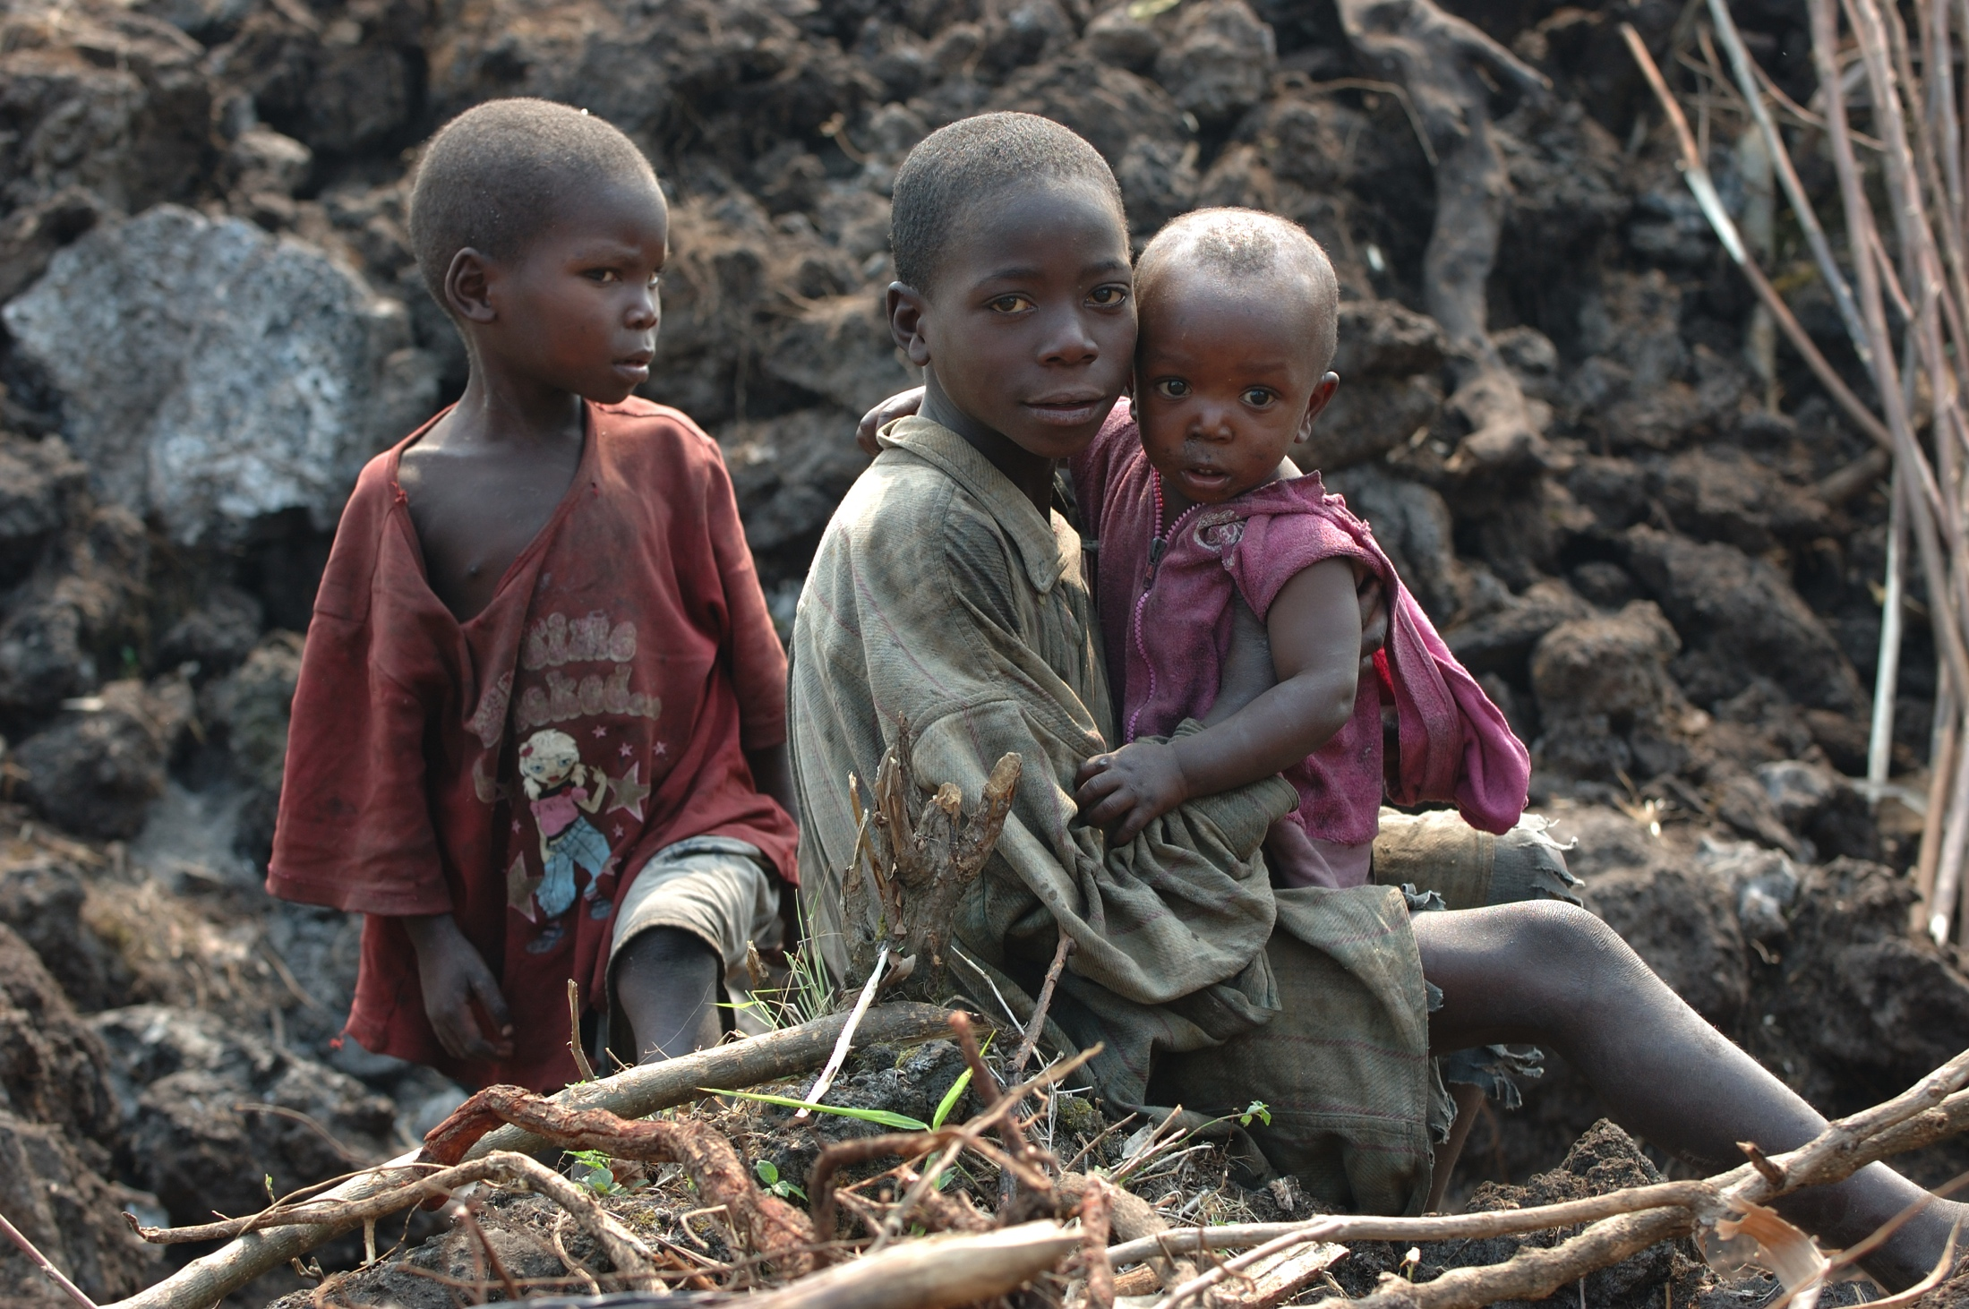
Some Human Rights
Not everyone agrees on what human rights should be.
Divide into groups of three (3). One person should be the recorder.
In ten minutes list as many human rights as you can think of.
Now compare with the other groups and come up with a master list.
Notes:
You may want to write a stem for them to finish, such as: A person should be able to………. (have an education, live in safety, have enough to eat, have clean water, have a decent home, have adequate clothing, worship freely, vote on leaders, not live in slavery, and so on.)

Slide 12
Do We All Agree?
Many people do not think everyone should have freedom of religion.
Slavery exists in lots of the world.
Some think it is okay to take land, food, and water from other people.
Not everyone in the world agrees what rights are basic to all people.

Slide 13
What Rights are Most Important to YOU?
We will be playing a game to get you thinking about what rights are most important to you.
So start thinking!
Notes:
The game can be found in ppt. 2 “Buy Your Human Rights”. Game cards and instructions can also be found in a pdf.

