Slide 1
Native American Tribes of the Southwest
Writers of the Purple Sage

Slide 2
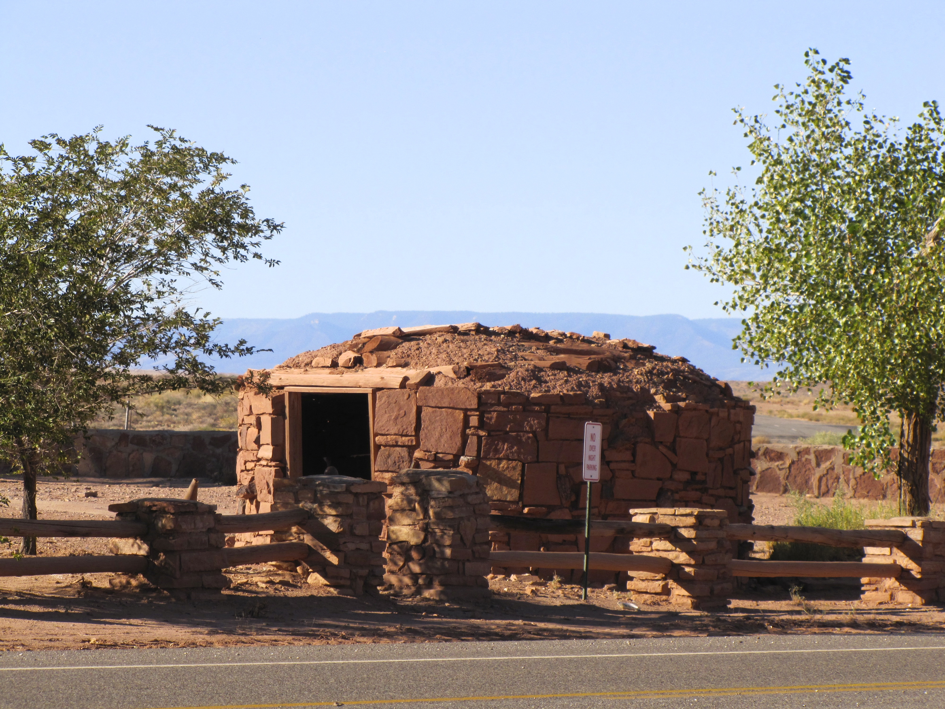
Native American Tribes of the Southwest
Originally there were many Native American tribes who called the Southwest (Arizona, New Mexico, and western Colorado) home. Today, there are five: Apache, Hopi, Navajo, Pueblo, and Zuni.
These tribes lived in villages and sustained themselves mostly by farming.

Slide 3
Native American Tribes of the Southwest
Southwestern tribes were known for their pottery, both for every day use and decoration/display.
Known for jewelry, silver belts and hand woven baskets as well
Turquoise was often used in jewelry.
Promotes health, happiness, and good fortune
Basket weaving methods have not changed in centuries
Zuni and Hopi carved dolls known as Kachina dolls out of wood
Decorated with masks and costumes to represent Kachina spirits
Helped children to learn tribal ceremonies

Slide 4
Apache
Apache
Tribal Origin: Apachean Family
Also known as: ápachu, means 'enemy’
Native Name: N'de, Dĭnë, Tĭnde and Inde, means 'people’
Home Territories: Arizona, New Mexico, Oklahoma, Texas and the Great Plains
Language: Chiricahua, Jicarilla, Lipan, Plains Apache, Mescalero and Western Apache
Enemies: Spanish, Mexicans and Americans
Point of Interest: Were known as great warriors and intelligent tacticians in battles

Slide 5
Comanche
Comanche
Tribal Origin: Shoshone
Native Name: Numunuu, means 'the People’
Home Territories: New Mexico, Colorado, Kansas, Oklahoma and Texas
Language: Comanche
Alliances: Apache and Kiowa
Enemies: American settlers at times
Point of Interest: Known for attacking on nights with a full moon and for their skills of fighting while on horseback

Slide 6
Havasupai
Havasupai
Tribal Origin: Yuman
Native Name: Havasupai, means 'blue or green water people’
Home Territories: Arizona
Language: Havasupai
Alliances: Hopi
Point of Interest: Generally, a very peaceful tribe. Mail is still delivered via mule

Slide 7
Hopi
Hopi
Tribal Origin: Siouan Family
Also known as: Hopita, means 'peaceful ones’
Native Name: Hópitu-shínumu, means 'the peaceful people’
Home Territories: Arizona
Language: Hopi
Alliances: Navaho
Point of Interest: Have lived in America for many centuries. The Hopi have strong sense of moral character and their religion is one of anti-war

Slide 8
Jemez
Jemez
Tribal Origin: Pueblo
Native Name: Hä'-mish
Home Territories: New Mexico
Enemies: Spanish
Point of Interest: Typically lived in pueblos

Slide 9
Kiowa
Kiowa
Tribal Origin: Kiowa
Native Name: Kgoy-goo, means 'principle people’
Home Territories: Colorado and Oklahoma
Language: Kiowa
Alliances: Comanches and the Apaches
Enemies: Cheyennes
Point of Interest: Nomatic tribe who survived by hunting buffalo and eating vegetables

Slide 10
Lipan
^{Lipan}
^{Tribal Origin: Apache}
Native Name: Náizhan, means 'ours’
Home Territories: New Mexico, Texas and Mexico
^{Language: Apache}
Enemies: Comanche, Mescalero and Spanish
Point of Interest: Were known to cause a lot of trouble in Mexico

Slide 11
Maricopa
Maricopa
Tribal Origin: Yuman
Also known as: Piipaash
Native Name: Hasínai, means 'people’
Home Territories: Gulf of California and Arizona
Language: Maricopa
Alliances: Pima
Point of Interest: Known for pottery

Slide 12
Mohave
Mohave
Tribal Origin: Yuman
Also known as: Mojave
Native Name: Aha Macave, means 'people who live along the river’
Home Territories: Arizona, California and Nevada
Language: Mojave
Enemies: United States
Point of Interest: Instead of canoes, they were known to make rafts from balsa

Slide 13
Navajo
Navaho
Tribal Origin: Southern Athabascan
Also known as: Diné or Navajo, means 'the people’
Native Name: Navajo
Home Territories: Arizona, Colorado and New Mexico
Language: Navajo
Enemies: United States
Point of Interest: Largest tribe in the United States today

Slide 14
Paiute
Paiute
Tribal Origin: Uto-Aztecan family
Also known as: Piute, possibly means 'Water Ute’
Home Territories: Arizona, California, Nevada and Utah
Language: Paiute
Enemies: Navajo and Utes
Point of Interest: Were sold into slavery by the Navajo and Utes

Slide 15
Papago
Papago
Tribal Origin: Pima
Native Name: Tohono O'odham, means 'People of the Desert’
Home Territories: Arizona and Mexico
Language: O'odham
Enemies: Apaches
Point of Interest: Held onto their traditions even through attempts to be assimilated into American society

Slide 16
Pima
Pima
Tribal Origin: O'odham
Also known as: Akimel O'odham, means 'river people’
Native Name: Pima, means 'I don't know’
Home Territories: Arizona
Language: O'odham
Point of Interest: Known for being good farmers and for setting up irrigation systems

Slide 17
Pueblo
Pueblo
Pueblo Tribes: Jemez, Keresan Pueblos, Piro Pueblos, Tewa Pueblos, Tiwa Pueblos, Zuni, and Hopi
Home Territories: Arizona, Colorado, New Mexico, Nevada and Texas
Language: Multiple
Point of Interest: Lived in stone houses and cliff dwellings

Slide 18
Tewa
Tewa
Tribal Origin: Tanoan family
Also known as: Tano
Native Name: Tewa, means 'moccasins’
Home Territories: Arizona and New Mexico
Language: Tewa
Point of Interest: Developed their own written language

Slide 19
Ute
Ute
Tribal Origin: Shoshonean Tribe
Native Name: Ute, means 'people on the bank’
Ute Tribes: Capote, Cumumba, Kapote, Moache, Moanumts, Pah Vant, Parianuche, San Pitch, Sheberetch, Taviwach, Timanogots, Tumpanawach, Uinta, Uncompahgre, White River, Weeminuche and Yamperika
Home Territories: Colorado, New Mexico and Utah
Language: Ute
Point of Interest: Known for the exquisite beadwork

Slide 20
Yavapai
Yavapai
Tribal Origin: Possibly Yuman
Native Name: Yavapai, means 'people of the sun’
Home Territories: Arizona
Language: Yavapai
Alliances: Western Apache
Enemies: Maricopa and Pima
Point of Interest: Their form of attack was generally one of attack and retreat

Slide 21
Yuma
Yuma
Tribal Origin: Yuman
Also known as: Quechan
Native Name: K-wichhna
Home Territories: Arizona
Language: Quechan
Enemies: United States
Point of Interest: Were known for cultivating pumpkins, melons, corn and beans

Slide 22
Zuni
Zuni
Tribal Origin: Pueblos
Native Name: A'shiwi, means 'the flesh’
Home Territories: New Mexico
Language: Zuni
Point of Interest: Known to be an extremely peaceful tribe who lived off the land

Slide 23
Credits
Background photo: Marble Canyon Hogan, taken by unit author, Rondi Aastrup
Native American photos from Wikipedia.com
Information from http://www.davemcgary.com/southwest-native-american-tribes.htm and http://indians.org/articles/southwest-indians.html

